Slide 1
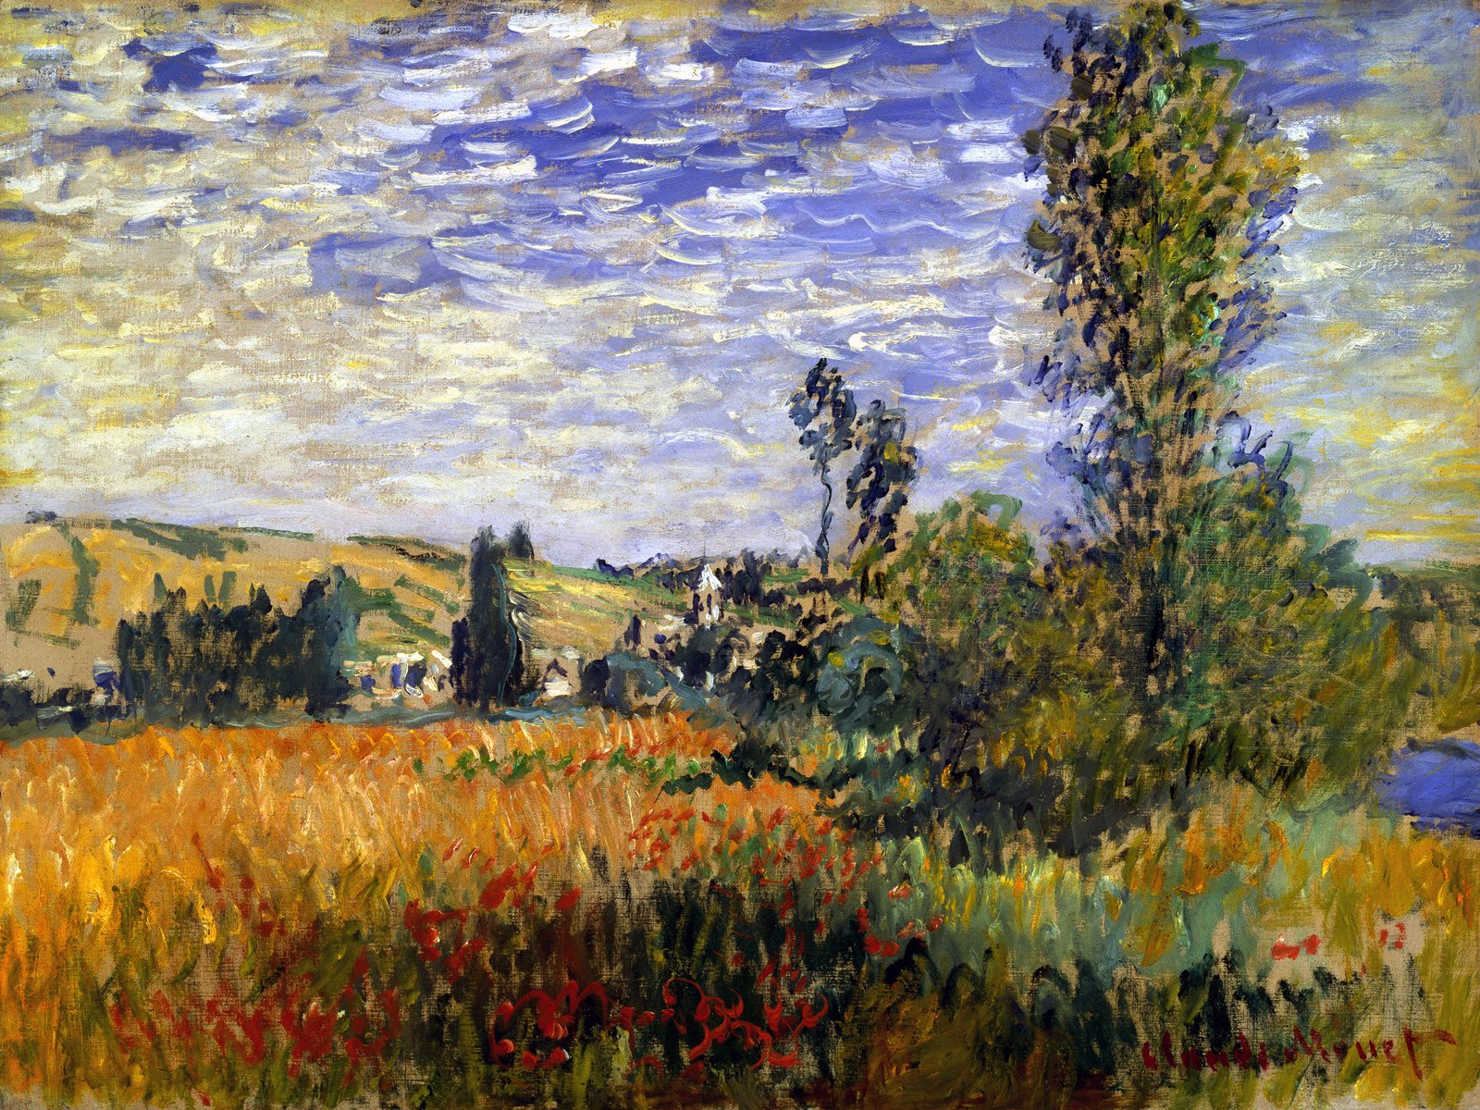
HyperScript
@kirjs

Slide 2
Create HyperText
with Java
Script,
on client
or server.
@kirjs

Slide 3
var h = require('hyperscript')
h ()
Javascript
<div></div>
HTML

Slide 4
h ('h1')
Javascript
<h1></h1>
HTML

Slide 5
h ('h1', 'Hello VueNYC')
Javascript
HTML
<h1>Hello VueNYC</h1>

Slide 6
h ('h1', 'Hello VueNYC')
Javascript
HTML
<h1>Hello VueNYC</h1>

Slide 7
h ('h1.vue#id', 'Hello VueNYC')
Javascript
HTML
<h1 class="vue" id = "id"> Hello VueNYC </h1>

Slide 8
h('a', {
href: 'http://kirjs.com'
}, '@kirjs')
Javascript
HTML
<a href="http://kirjs.com">@kirjs</a>

Slide 9
h('a', { onclick:()=>{ alert('Free kittens!!!') } }, '@kirjs')
Javascript

Slide 10
h('a', { style: { color: red } }, '@kirjs')
Javascript

Slide 11
h(div,
h('h1', '@kirjs')
)
Javascript
HTML
<div>
<h1>Hello VueNYC</h1>
</div>

Slide 12
var h = require('hyperscript') h('div#page', h('div#header', h('h1.classy', 'h', { style: {'background-color': '#22f'} })), h('div#menu', { style: {'background-color': '#2f2'} }, h('ul', h('li', 'one'), h('li', 'two'), h('li', 'three'))), h('h2', 'content title', { style: {'background-color': '#f22'} }), h('p', "so it's just like a templating engine,\n", "but easy to use inline with javascript\n"), h('p', "the intention is for this to be used to create\n", "reusable, interactive html widgets. "))
Javascript

Slide 13
h('h1', 'Hello VueNYC').outerHTML
How to get HTML
Javascript
<h1>Hello VueNYC</h1>

Slide 14
h('vue-component', {}, h('h1', '@kirjs')})
Using with vue
Javascript

Slide 15
https://github.com/hyperhype/hyperscript

